Slide 1

Welcome To Ram Technologies Bangalore
Empowering the Next Generation of DevOps Engineers

Slide 2
Why I Teach?
Passionate about knowledge sharing
Realized the gap between theoretical and practical DevOps
Aim to provide industry-relevant, hands-on training
Want to mentor the next generation of DevOps professionals

Slide 3
What You Can Expect?
Hands-on labs and real-world project scenarios
Focus on core DevOps concepts + cloud-native tools
Tips for certifications, interviews, and career growth
Ongoing support, feedback, and mentorship

Slide 4

Market Trends & Career Scope
DevOps is rapidly growing, with more companies adopting DevOps practices to accelerate software delivery. The demand for skilled DevOps engineers is high, and many companies are looking for professionals with expertise in tools like Docker, Kubernetes, Jenkins, and Terraform.
Trends:
  Increased use of Cloud Services (AWS, Azure, GCP).
  Rise of Infrastructure as Code (IaC) tools like Terraform and Ansible.
  Growing focus on Security (DevSecOps), integrating security practices into the CI/CD pipeline.
  Expansion of Automation to improve efficiency.

Slide 5
Career Scope:
  DevOps Engineer
  Site Reliability Engineer (SRE)
  Cloud Engineer
  Automation Engineer
  Release Manager
  DevSecOps Engineer

Slide 6
Software Development Life Cycle (SDLC)
The Software Development Life Cycle (SDLC) is a structured process that defines the stages involved in the development of software.
SDLC Models:
1.Waterfall Model
2.Agile
3.DevOps

Slide 7
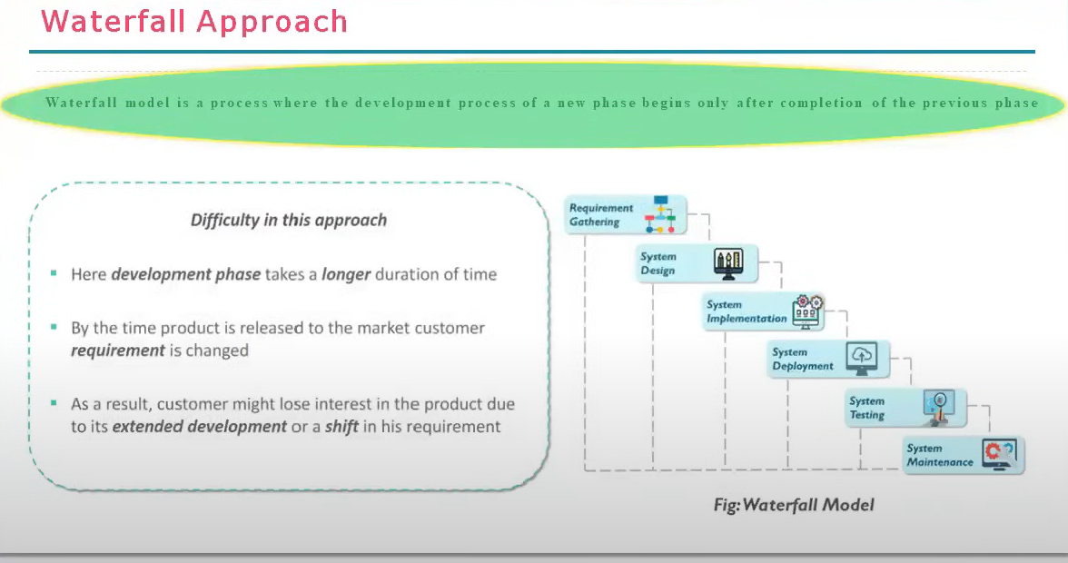

Slide 8
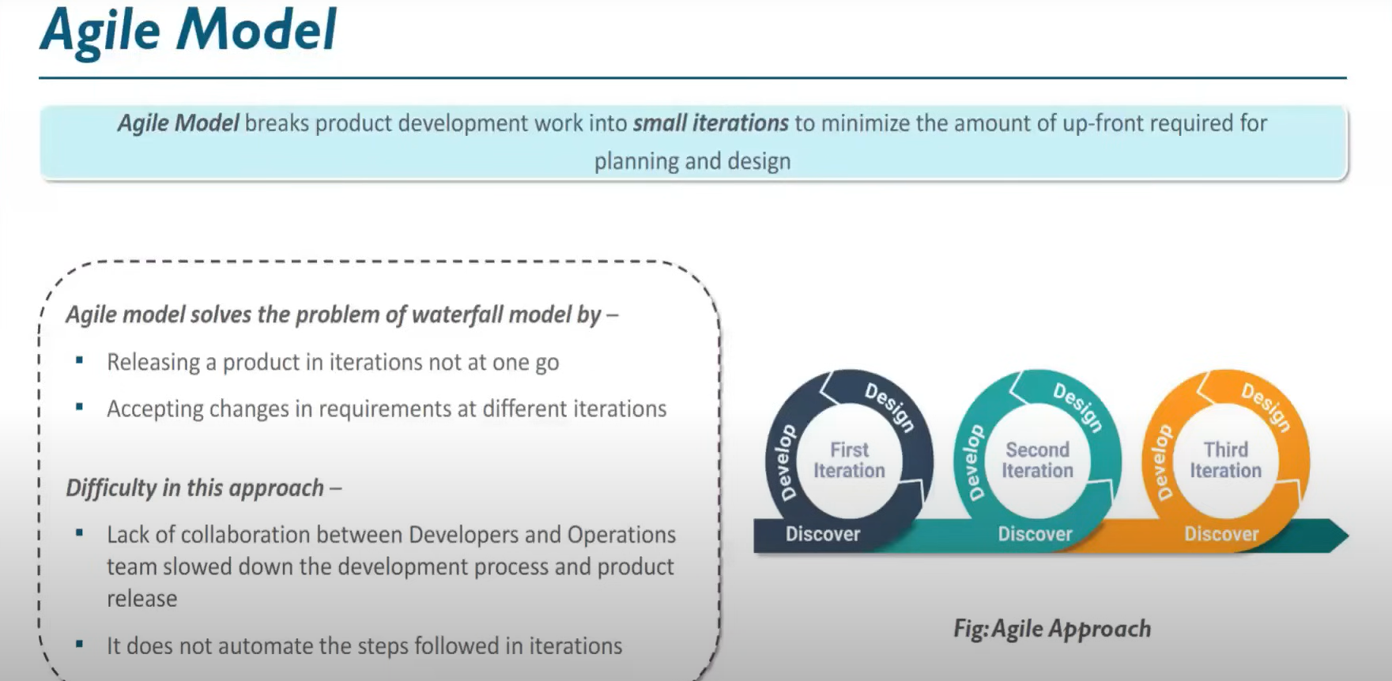

Slide 9
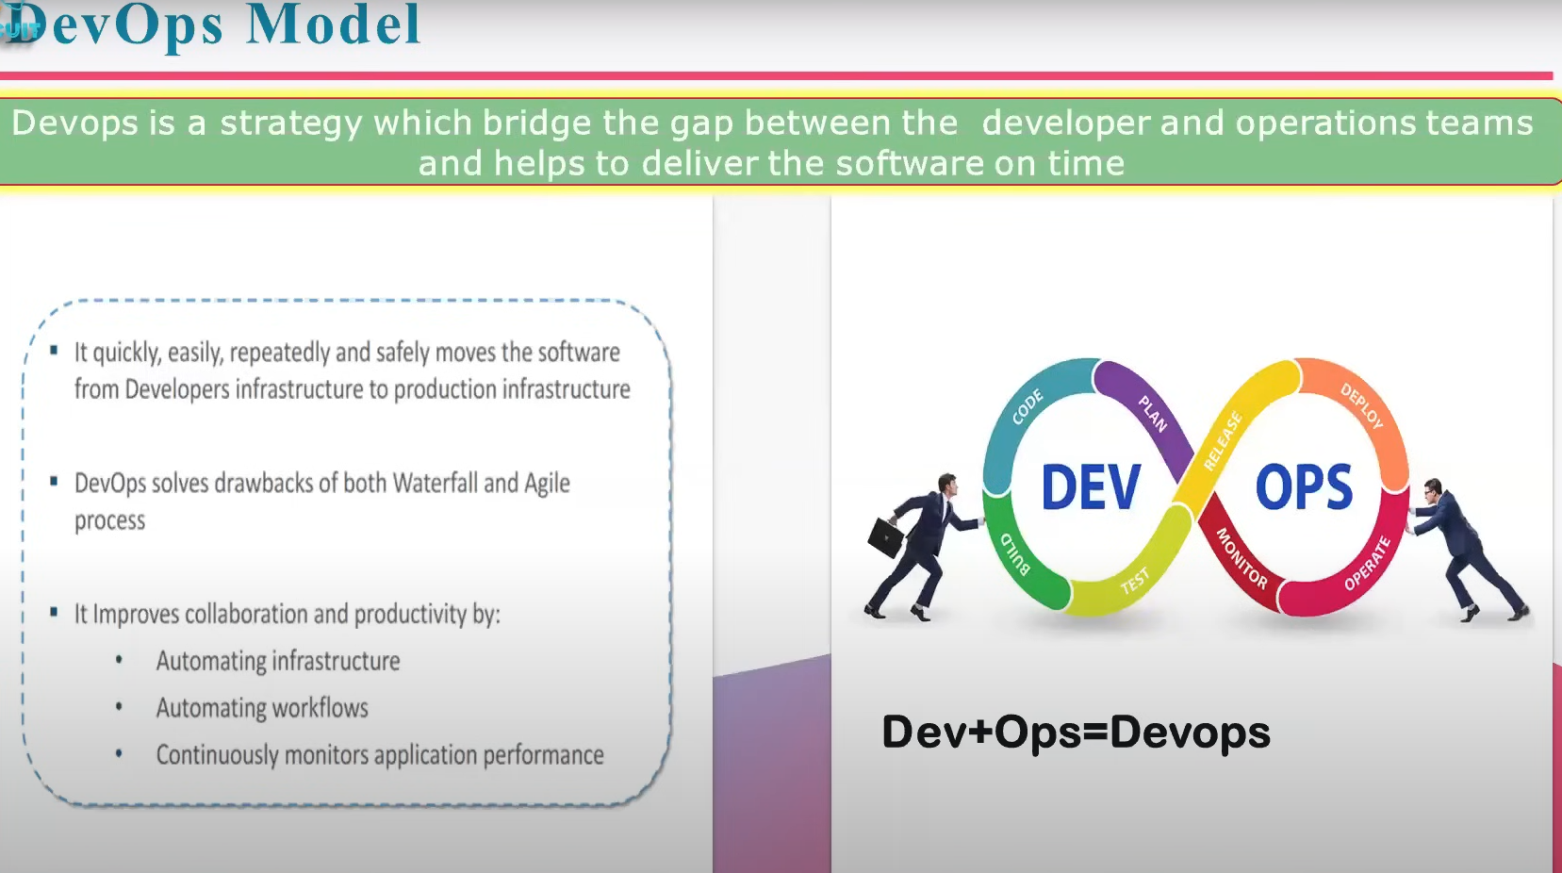

Slide 10
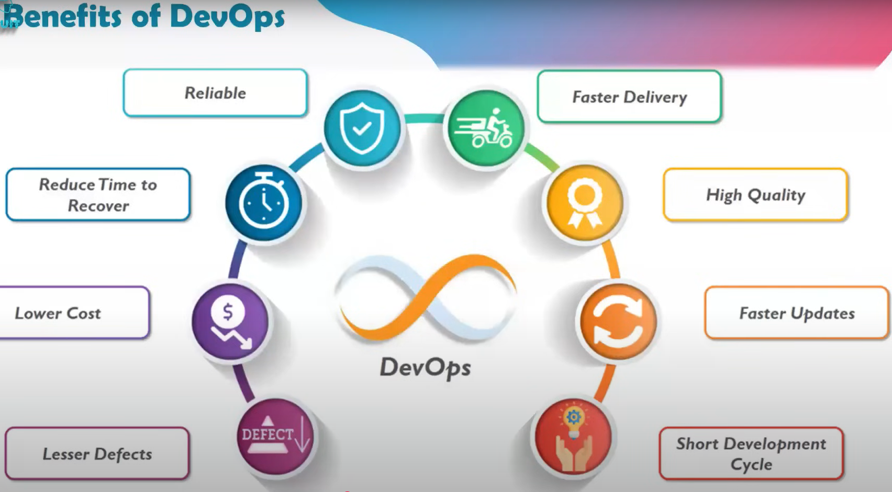
What is DevOps?
DevOps is a culture and set of practices that bring together software development (Dev) and IT operations (Ops) teams to collaborate throughout the software development lifecycle. The goal is to shorten development cycles, increase deployment frequency, and improve software quality.
Example: In DevOps, developers and operations teams work together on the same goals, using automation to streamline repetitive tasks like code deployment, configuration management, and testing.

Slide 11
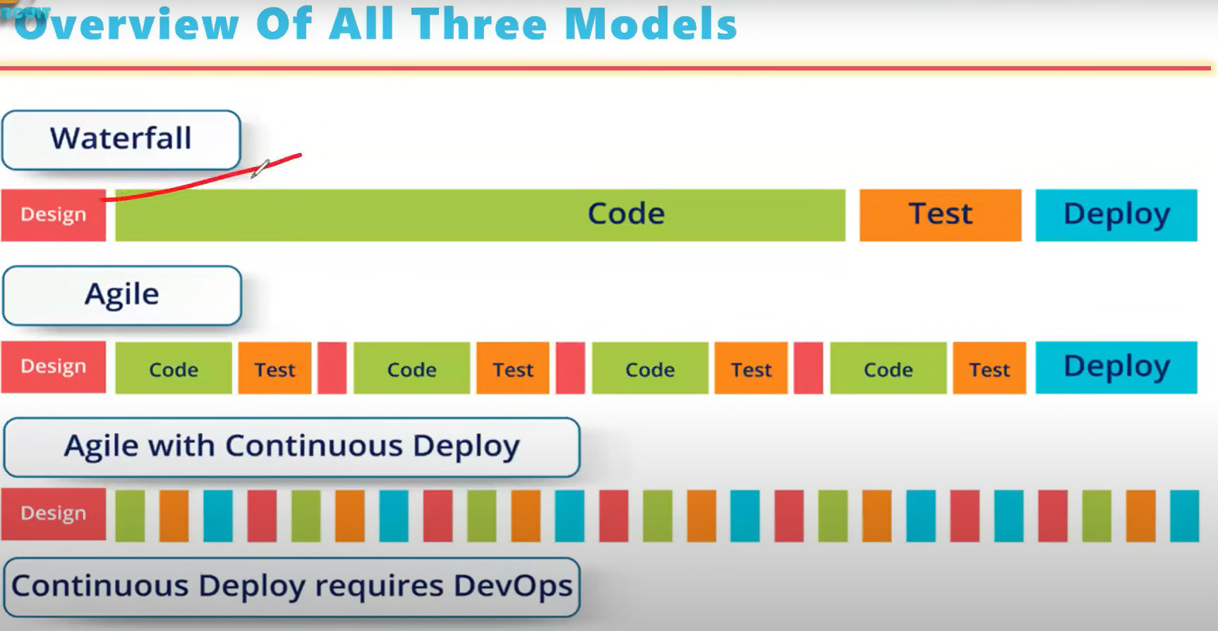

Slide 12
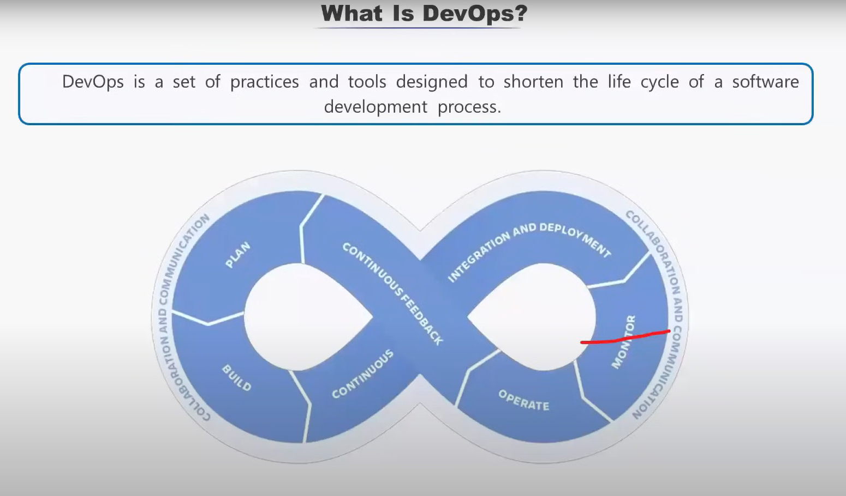

Slide 13
Thankyou!!

